Slide 1

1B – Parameter fitting & recovery
Klaus Wimmer
Centre de Recerca Matemàtica
Barcelona, Spain kwimmer@crm.cat
BAMB! 2023 Summer School

Slide 2
The plan for the next 120 minutes
Parameter estimation
Model fitting as an optimization problem
Model validation
Does the model capture the data?
Parameter recovery
Simulate, simulate, simulate!
Parameter uncertainty
Bootstrapping
Notes:
Uncertainty around parameter estimates: bootstrapping
Tutorial:
parameter recovery and bootstrapping for model B
model validation example

Slide 3
Fit the parameters
Find maximum of p(data | theta)
=> maximum likelihood estimation (MLE)
Model fitting via point estimation
Goal: find x_{opt} = argmin f(x) as fast as possible
Often f(x) is a black box; sometimes we can compute the gradient
Solution: feed f(x) to an optimization algorithm
Notes:
MLE: point estimate; cf. Bayesian posterior estimation; MAP estimate; best single value of the parameters (parameter vector)
Bayesian way: estimate the posterior: variational inference, sampling methods
Log-likelihoods = Nan or infinity is a problem;

Slide 4
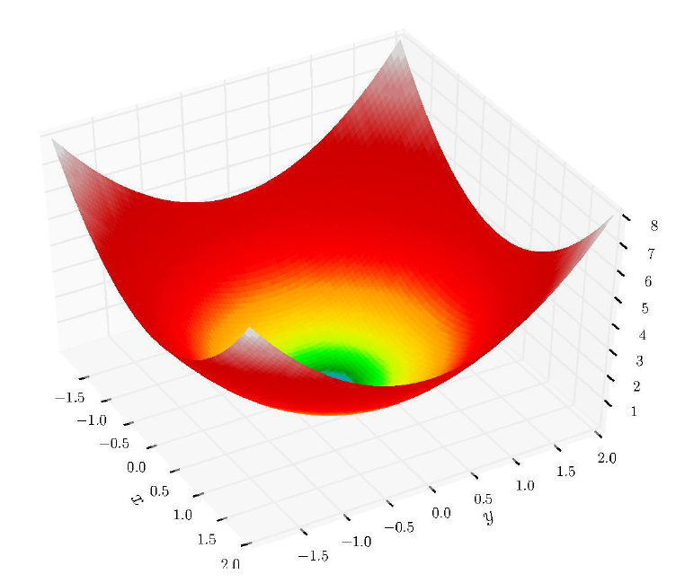
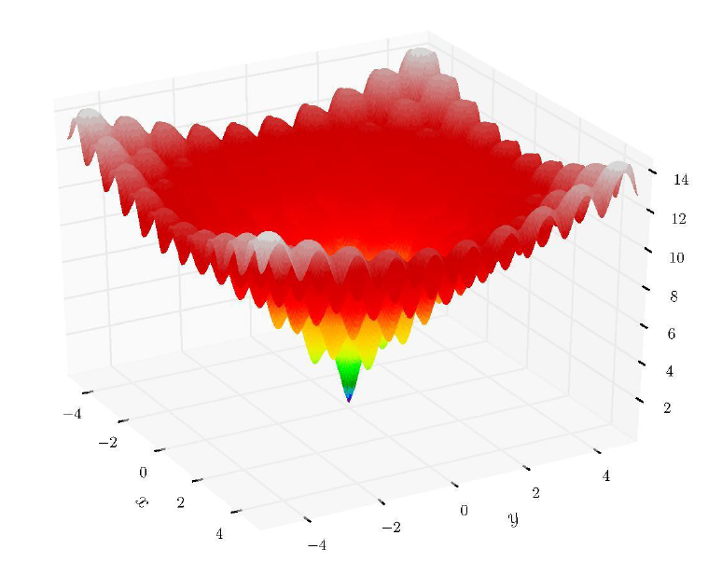
How hard can it be?
Notes:
MLE: point estimate; cf. Bayesian posterior estimation; MAP estimate; best single value of the parameters (parameter vector)
Bayesian way: estimate the posterior: variational inference, sampling methods
Log-likelihoods = Nan or infinity is a problem;

Slide 5
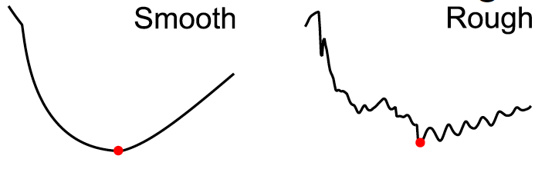
Optimization can be hard
Optimizer does not see the landscape
Multiple local minima or saddle points
Expensive function evaluation (>> 1 s)
Noisy function evaluation (stochastic problem)
Rough landscape (numerical approximations, etc.)
Notes:
MLE: point estimate; cf. Bayesian posterior estimation; MAP estimate; best single value of the parameters (parameter vector)
Bayesian way: estimate the posterior: variational inference, sampling methods
Log-likelihoods = Nan or infinity is a problem;

Slide 6
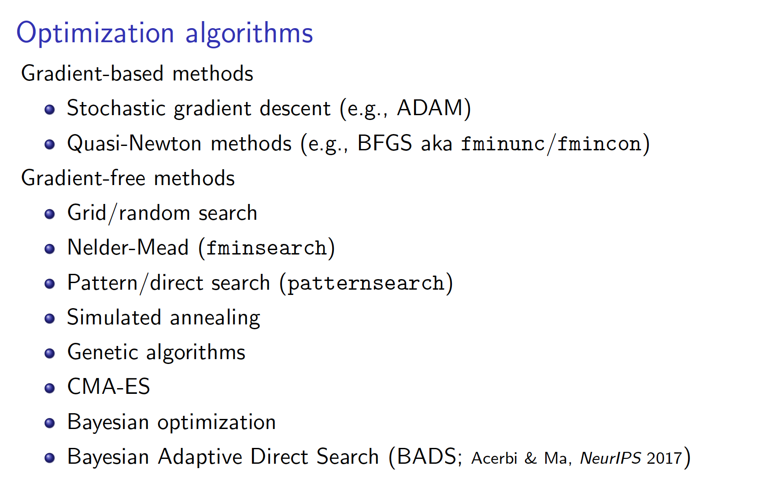
See intro to optimization by Luigi Acerbi in BAMB! 2022: https://github.com/lacerbi/bamb2022-model-fitting
Notes:
MLE: point estimate; cf. Bayesian posterior estimation; MAP estimate; best single value of the parameters (parameter vector)
Bayesian way: estimate the posterior: variational inference, sampling methods
Log-likelihoods = Nan or infinity is a problem;

Slide 7
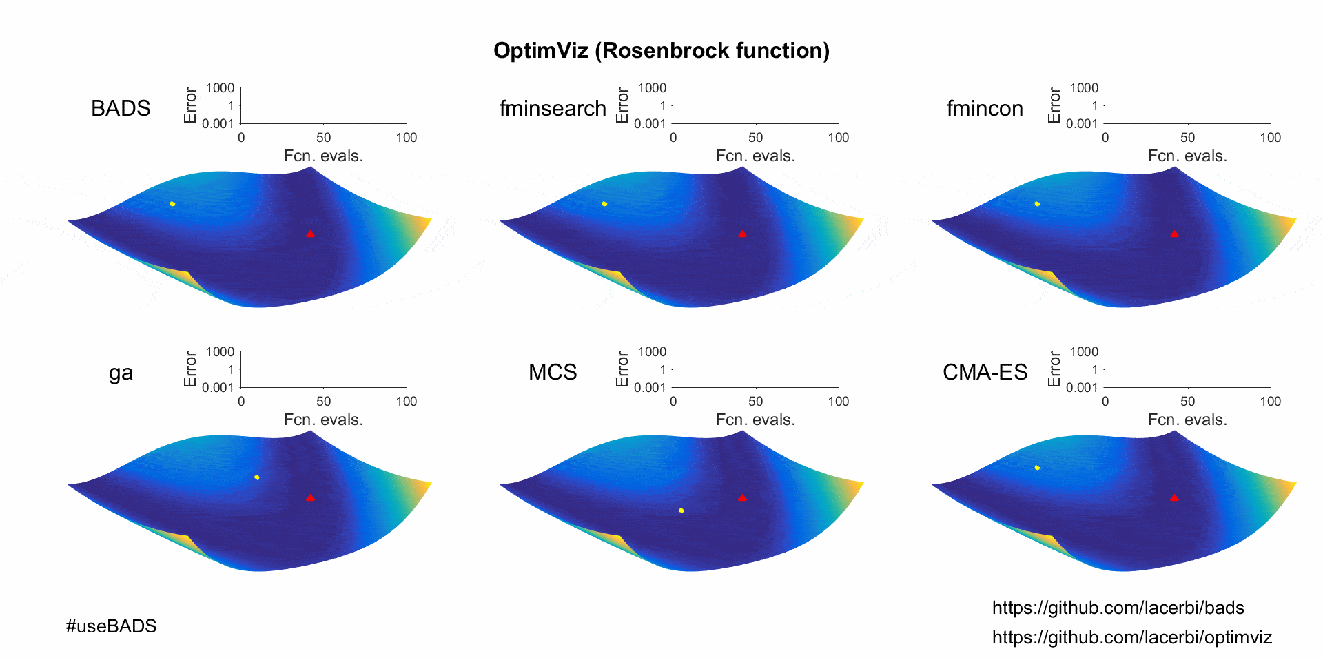
Optimizers at work
BADS: Acerbi and Ma (2017)
Notes:
Rosenbrock banana function; a non-convex function, The global minimum is inside a long, narrow, parabolic shaped flat valley. To find the valley is trivial. To converge to the global minimum, however, is difficult.
Used a test case for optimization algorithms
BADS is a global optimizer

Slide 8
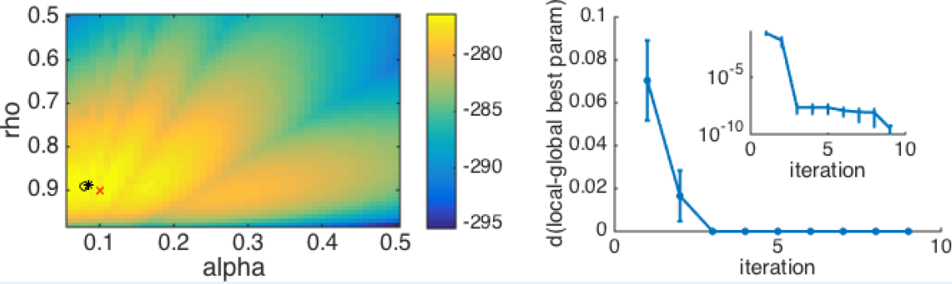
Tips and tricks
Be sure that your log-likelihoods are finite (e.g. initial conditions)
Carefully choose constraints on parameters (avoid solutions at the bounds): hard bounds and plausible bounds
Consider reparameterization (independence between parameters)
Beware of local minima (always run fitting multiple times with random initial conditions)
Wilson & Collins (2019) eLife
Notes:
MLE: point estimate; cf. Bayesian posterior estimation; MAP estimate; best single value of the parameters (parameter vector)
Bayesian way: estimate the posterior: variational inference, sampling methods
Log-likelihoods = Nan or infinity is a problem; Include checks in the code for valid log-likelihoods

Slide 9
Model validation
Does the model capture the data in an absolute sense?
Does the model get the essence of the behavior?
How to validate the model?
Simulate the model with the fit parameter values and then analyze the simulated data in the same way that you analyzed the empirical data (model-independent analysis).
Verify that all important behavioral effects are captured by the model
Notes:
Note, that model-indepent analysis should always be the first step (“is there any evidence for the expected results?”)

Slide 10
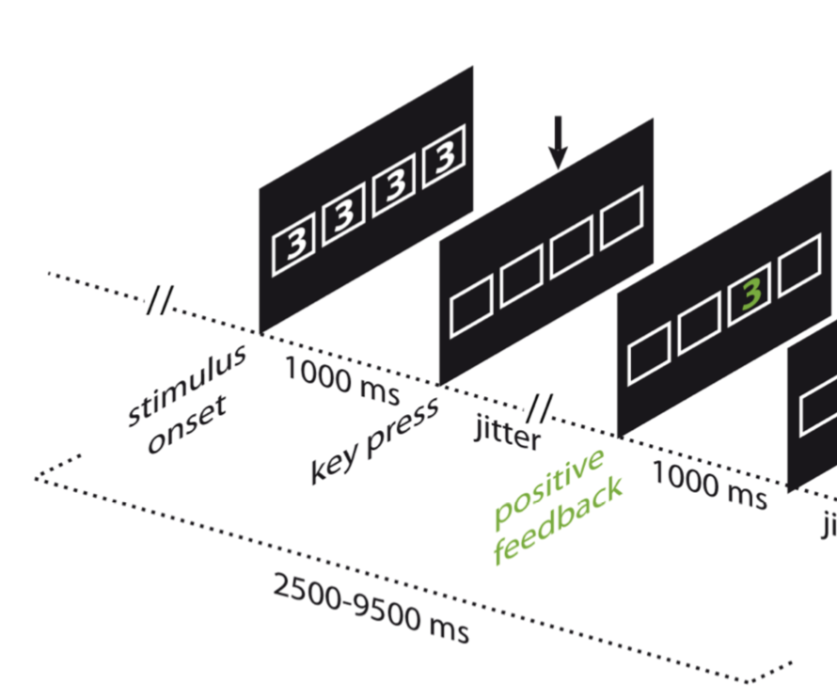
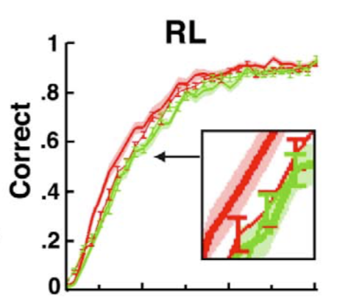
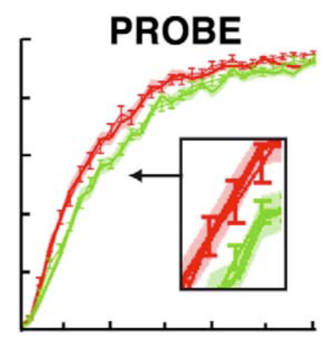
Example for qualitative criteria: what behavioural signatures do you care about
In cognitive and behavioral science, often our data points are trials or decisions or responses ...
... But not all responses matter equally ⚖️
Example: Both RL and PROBE models make similar predictions at the plateau level, after participants have learnt the contingencies
But after a reversal, key differences are observed:
Collins and Koechlin (2012)
Notes:
Analyse your behavior in many different ways💡
Aggregate measures of behavior, e.g. coarse bar graphs, averages across conditions and participants ... Might not allow you to disentangle between different models ie different accounts of behavior

Slide 11
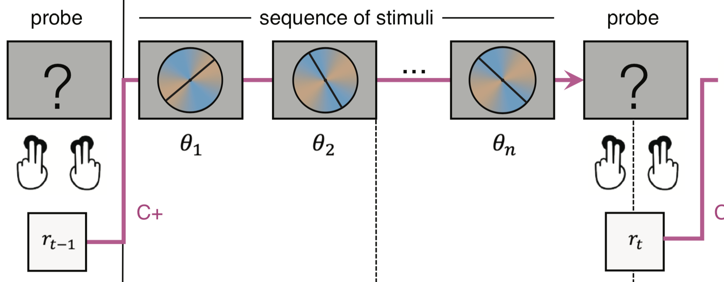
Example: model validation
Decision-making task under uncertainty
Bayesian inference model plus different sources of noise
Rouault et al, eLife (2022)
Notes:
Describe experiment (18min)

Slide 12
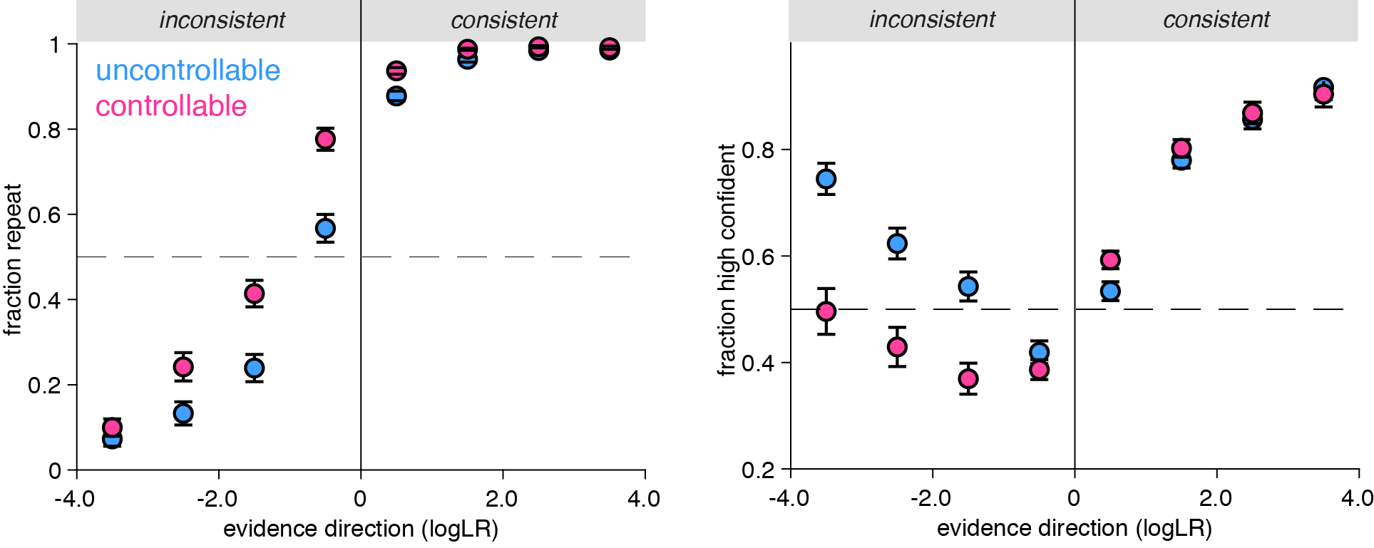
Example model validation
Participants need more evidence to change their mind in controllable environments
When they change their mind, they do so with reduced confidence
Rouault et al, eLife (2022)
Notes:
Human data

Slide 13
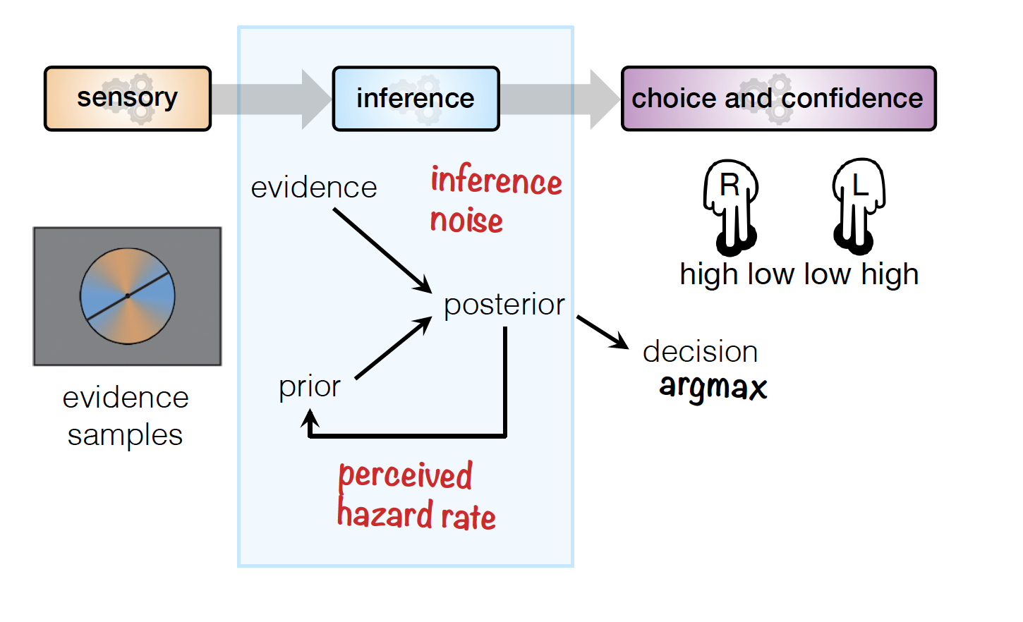
Example model validation
L
Rouault et al, eLife (2022)
Notes:
First, we introduced a confidence threshold parameter for determining whether the response will be provided with high or low confidence based on the posterior belief about the chosen category. This parameter captured baseline differences in proportion of high confidence responses between conditions, representing the most parsimonious extension possible to provide a normative confidence response. Second, we introduced metacognitive noise to model an imperfect readout, in line with previous studies (Pouget et al., 2016; Maniscalco & Lau, 2012). Third, we introduced a confidence gain parameter on switch trials modeling a differential readout of the posterior belief on changes-of-mind only, as a multiplicative factor on the posterior belief applied on switch trials only.

Slide 14
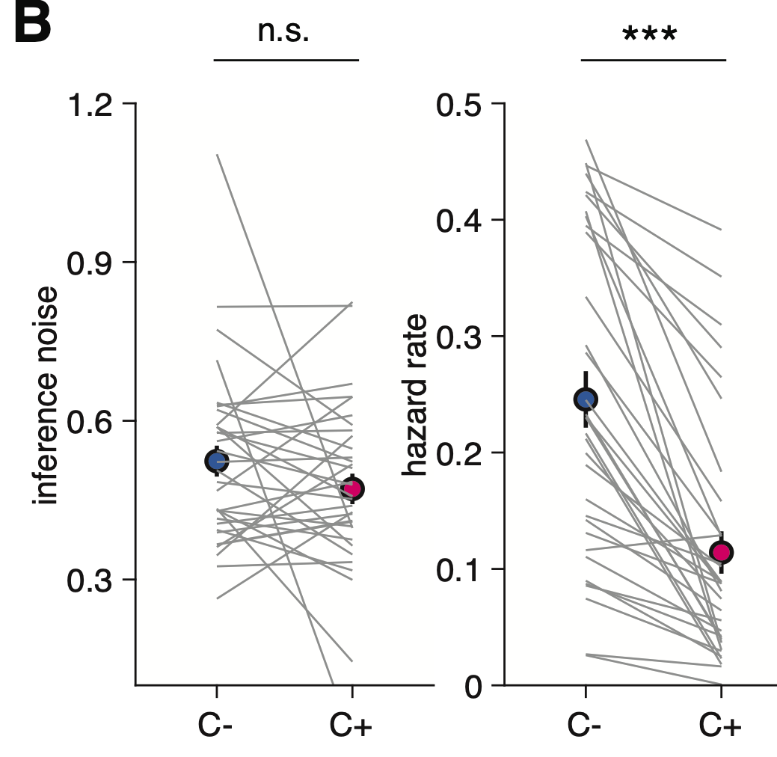
Example model validation
Rouault et al, eLife (2022)
Notes:
First, we introduced a confidence threshold parameter for determining whether the response will be provided with high or low confidence based on the posterior belief about the chosen category. This parameter captured baseline differences in proportion of high confidence responses between conditions, representing the most parsimonious extension possible to provide a normative confidence response. Second, we introduced metacognitive noise to model an imperfect readout, in line with previous studies (Pouget et al., 2016; Maniscalco & Lau, 2012). Third, we introduced a confidence gain parameter on switch trials modeling a differential readout of the posterior belief on changes-of-mind only, as a multiplicative factor on the posterior belief applied on switch trials only.

Slide 15
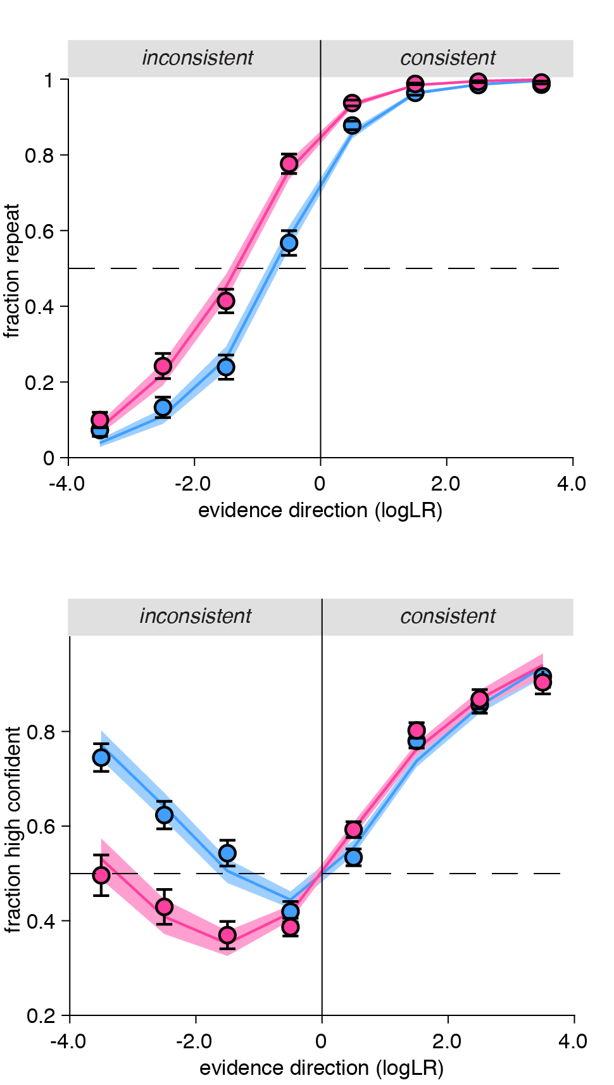
Example model validation
Full model
Reduced model
💭 Can you recover/
reproduce all qualitative and quantitative results obtained from your actual data?
Rouault et al, eLife (2022)
Notes:
Differences that would have been invisible on aggregate data

Slide 16
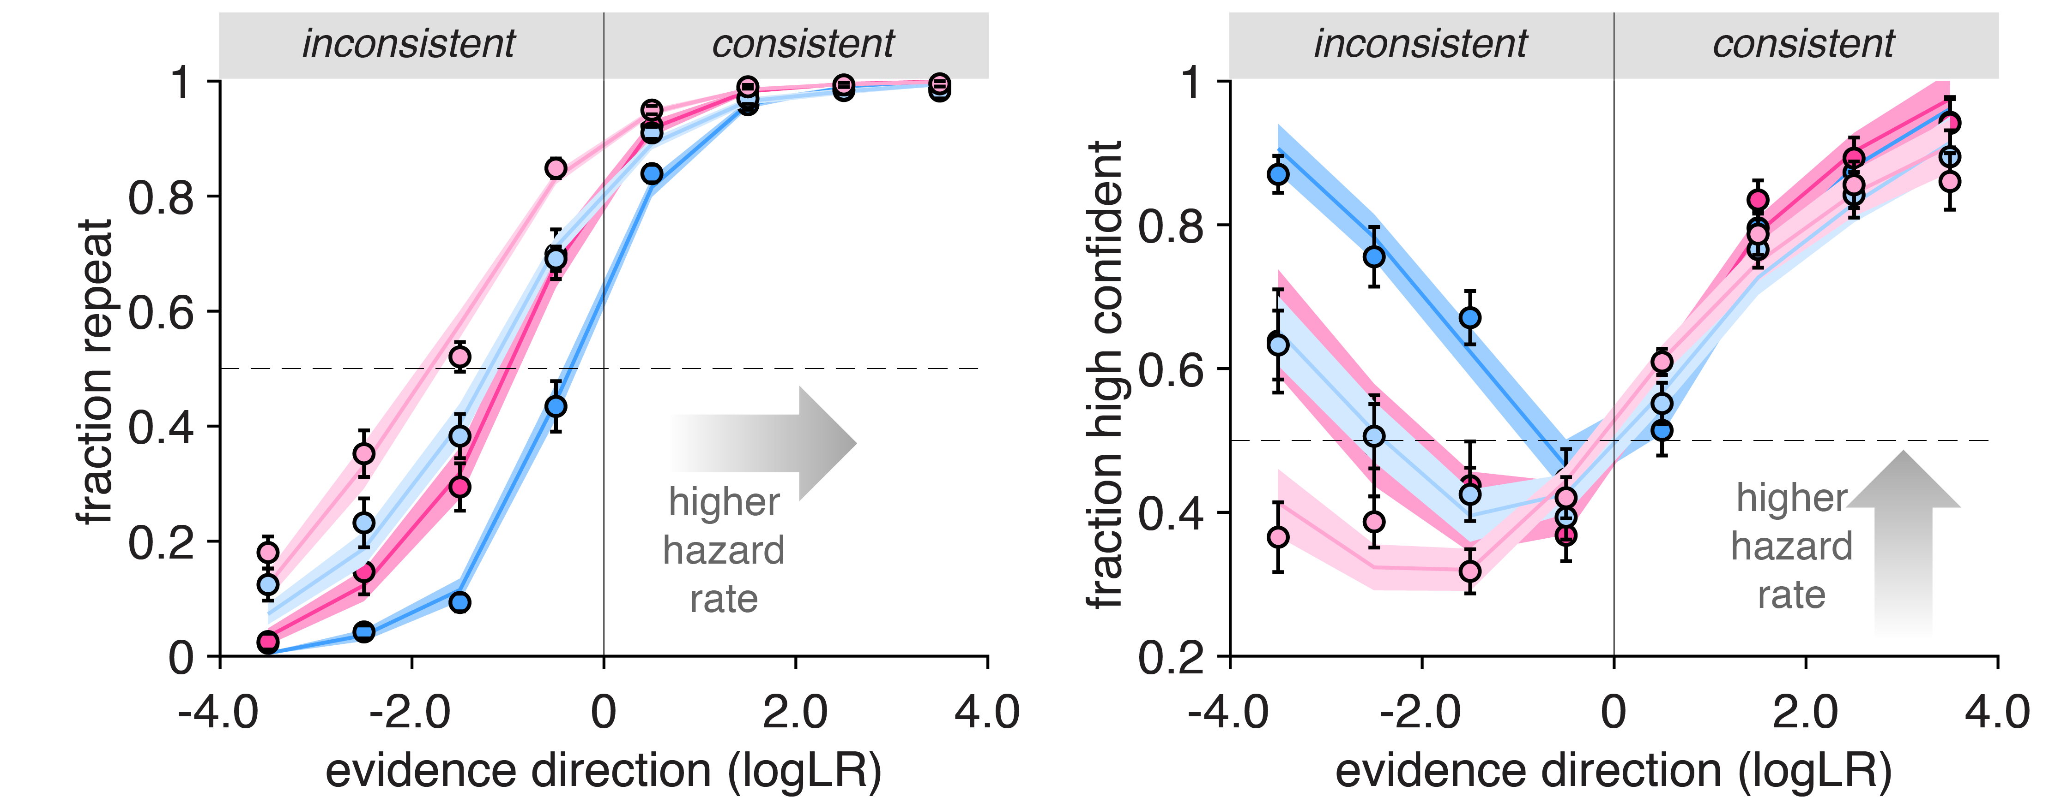
Model validation: fit and simulate
Median split of participants with high and low hazard rate
Verify that your parameter has the expected effects on behavioral signatures => Further validation for your model
Rouault et al, eLife (2022)

Slide 17
Parameter recovery
Check whether the fitting procedure gives meaningful parameter values in the best case scenario, that is, when fitting fake data where the “true” parameter values are known.
🤷‍
Why do we care?
Palminteri, Wyart & Koechlin (2017) TICS; Wilson & Collins (2019) eLife

Slide 18
Parameter recovery
🤷‍
Why do we care?
We want to avoid a biased fitting procedure
We want to avoid parameter roles overlapping with each other, capturing similar shares of the variance
We want each parameter to be identifiable
Under these conditions we will be able to interpret the meaning of each of the parameters
And potentially to interpret their different value in different conditions or under different treatment groups
Palminteri, Wyart & Koechlin (2017) TICS; Wilson & Collins (2019) eLife

Slide 19
Parameter recovery
1. Simulate fake data with different values of parameters (e.g., learning noise, choice temperature)
When choosing the range of parameter values, make sure that you are covering the parameter regime of interest for your experiment!
Either sweep across the whole parameter space
Or focus on the space of interest regarding your best-fitting parameters
2. Estimate the values of the parameters from your simulated data
3. Compare the recovered parameters to their true values (should be highly correlated without bias)
Are their bugs in your code? Is the experiment underpowered?
Palminteri, Wyart & Koechlin (2017) TICS; Wilson & Collins (2019) eLife
Notes:
Parameter recovery can be used to test statistical power for detecting a difference between populiations or condtions

Slide 20
Example parameter recovery
Rouault et al, eLife (2022)
Notes:
First, we introduced a confidence threshold parameter for determining whether the response will be provided with high or low confidence based on the posterior belief about the chosen category. This parameter captured baseline differences in proportion of high confidence responses between conditions, representing the most parsimonious extension possible to provide a normative confidence response. Second, we introduced metacognitive noise to model an imperfect readout, in line with previous studies (Pouget et al., 2016; Maniscalco & Lau, 2012). Third, we introduced a confidence gain parameter on switch trials modeling a differential readout of the posterior belief on changes-of-mind only, as a multiplicative factor on the posterior belief applied on switch trials only.

Slide 21
Example parameter recovery
Rouault et al, eLife (2022)

Slide 22
Example parameter recovery
Rouault et al, eLife (2022)

Slide 23
Example parameter recovery
Rouault et al, eLife (2022)

Slide 24
Confusion matrix: parameter identifiability
Rouault et al, eLife (2022)
Notes:
Attention: the two confusion matrices, for model recovery and parameter recovery look the same, but they are produced from different mechanisms
The confusion matrix for parameter recovery reflects correlation values
The model recovery confusion matrix reflects frequency of retrieval of the correct model
Parameter trade-off is sometimes unavoidable (important to not overinterpret correlations observed in the actual data)

Slide 25
Uncertainty about parameter estimates
Uncertainty around parameter estimates: how confident are you about your model fit?
Confidence interval of a population parameter: mean and confidence levels indicating the probability that the interval contains the parameter
Ideally, you would replicate your study several times and estimate the mean +/- margin of error
Traditional statistical techniques are only asymptotically correct (large N)
Sampling distributions are not known

Slide 26
Uncertainty about parameter estimates
In practice, a lot of times you do not know the shape of the underlying distribution from which your parameter is drawn: hence the error distribution cannot be easily calculated
Bootstrapping procedure, involves resampling your data
Employ resampling to estimate uncertainty around the obtained parameter value (i.e., confidence)
Repeatedly draw independent samples from a data set, that is, with replacement (resampling)
This creates a new data set, of same size as the initial one
We make the assumption that your data set is representative, a good measure of the underlying distribution

Slide 27
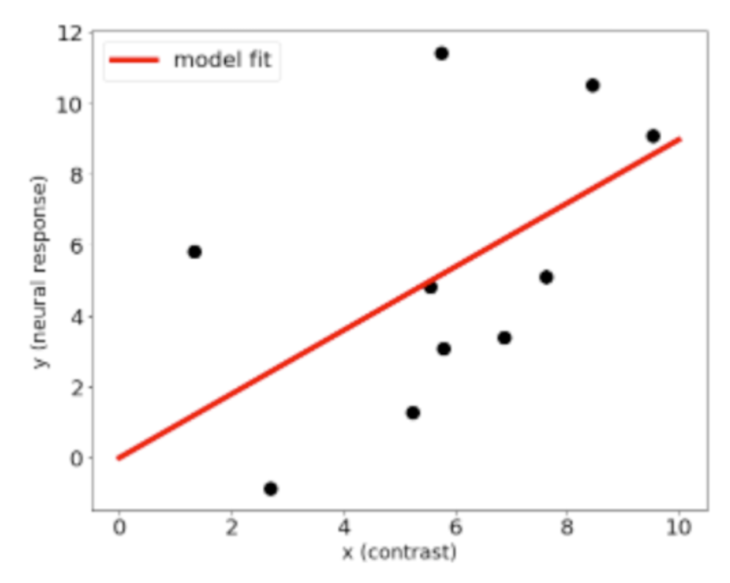
Example: Bootstrapping procedure
Uncertainty around parameter estimates: how confident are you about your model fit?
Example: a model fit of neural response as a function of contrast
Anqi Wu, neuromatch

Slide 28
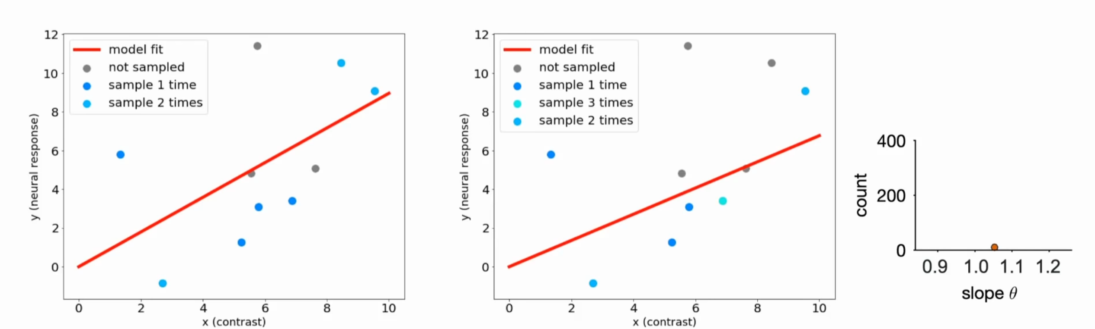
Bootstrapping procedure
1. Resample from the observed dataset with replacement
Notes:
Of course in practice we do not know the true underlying distribution of our parameter, that is the true slope, again in colour here.
Instead we have our data samples. And we will use bootstrapping

Slide 29
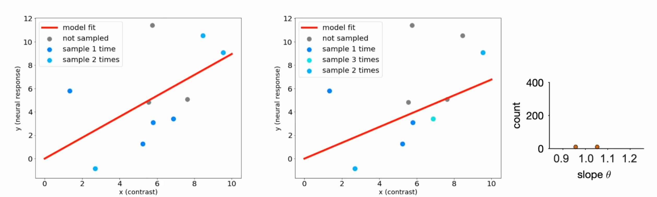
Bootstrapping procedure
1. Resample from the observed dataset with replacement
Notes:
Of course in practice we do not know the true underlying distribution of our parameter, that is the true slope, again in colour here.
Instead we have our data samples. And we will use bootstrapping

Slide 30
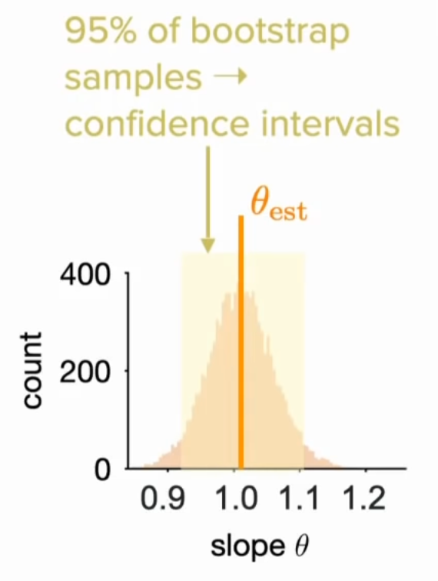
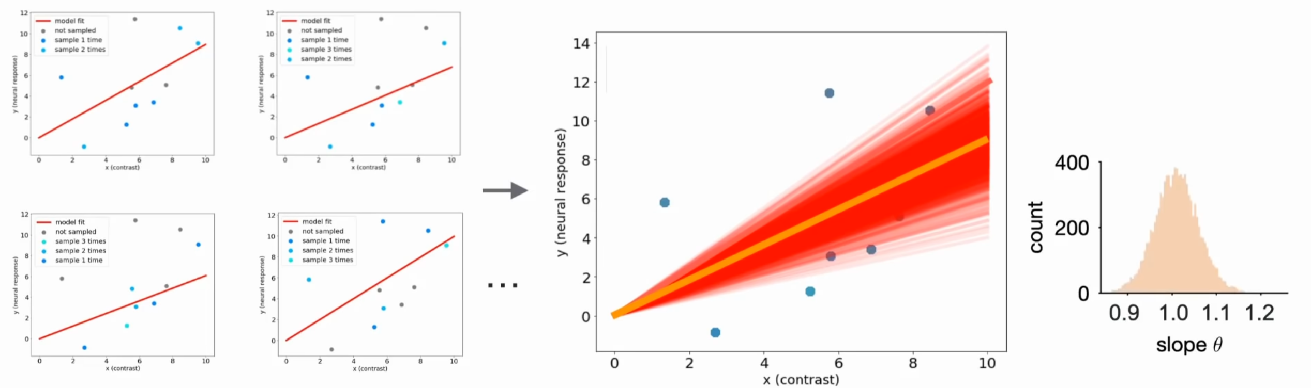
Bootstrapping procedure
Resample from the observed dataset with replacement
Collect all estimates into a distribution, and analyze the confidence intervals
The idea is to generate many new synthetic datasets from the initial true dataset by randomly sampling from it, then finding estimators for each one of these new datasets, and finally looking at the distribution of all these estimators to quantify our confidence.
Notes:
Of course in practice we do not know the true underlying distribution of our parameter, that is the true slope, again in colour here.
Instead we have our data samples. And we will use bootstrapping

Slide 31
Acknowledgements
🙏
Marion Rouault, CNRS & Paris Brain Institute (BAMB! 2022)
Luigi Acerbi (BAMB! 2022)
Anqi Wu (Neuromatch)

Slide 32
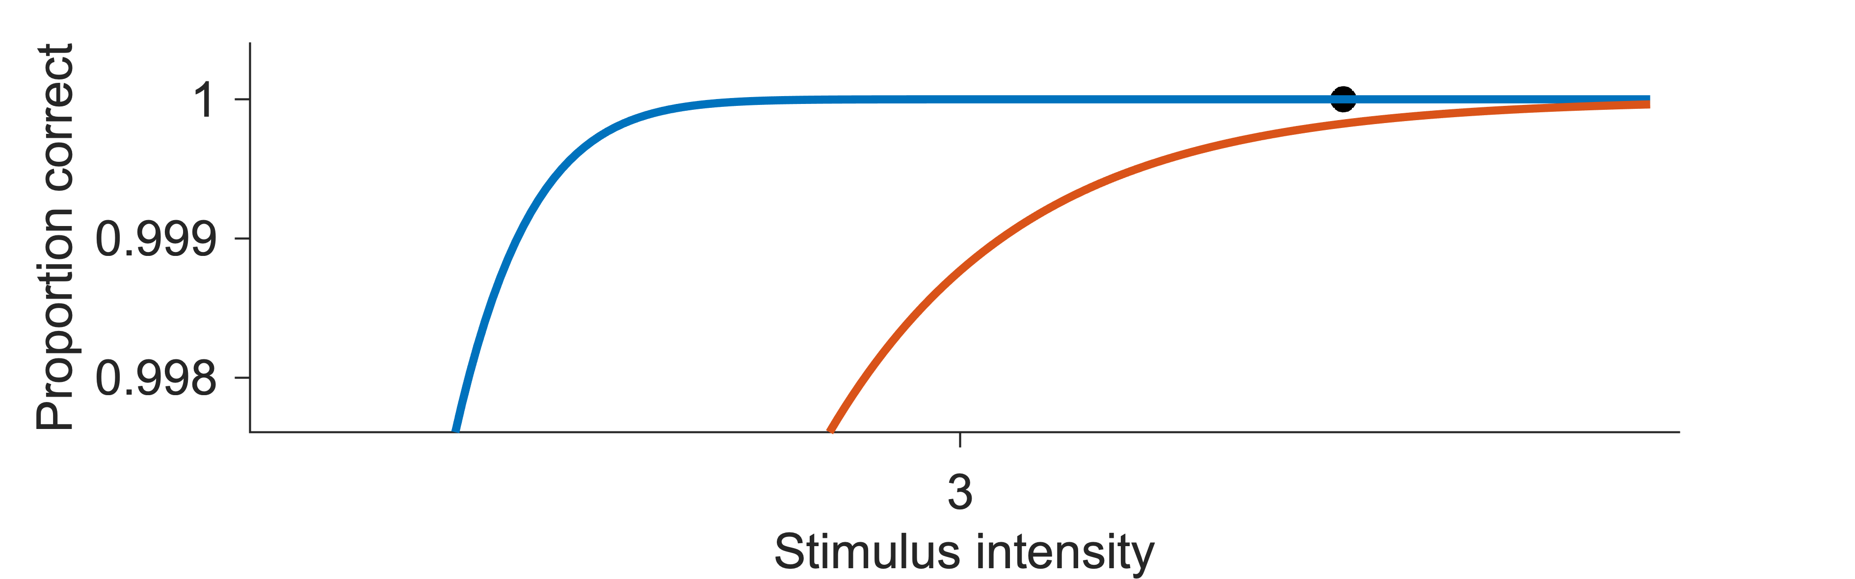
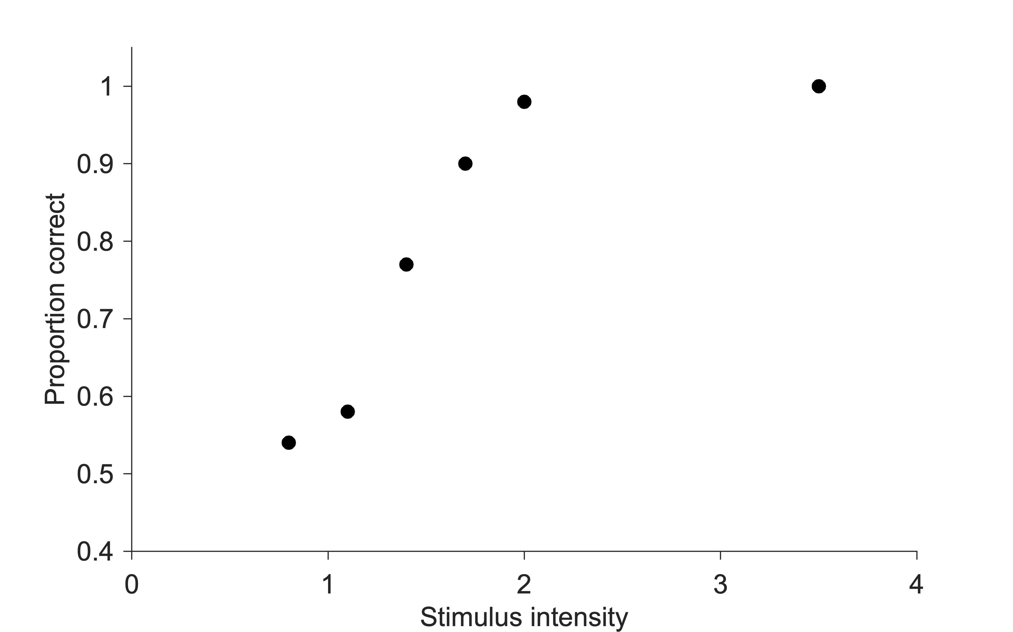
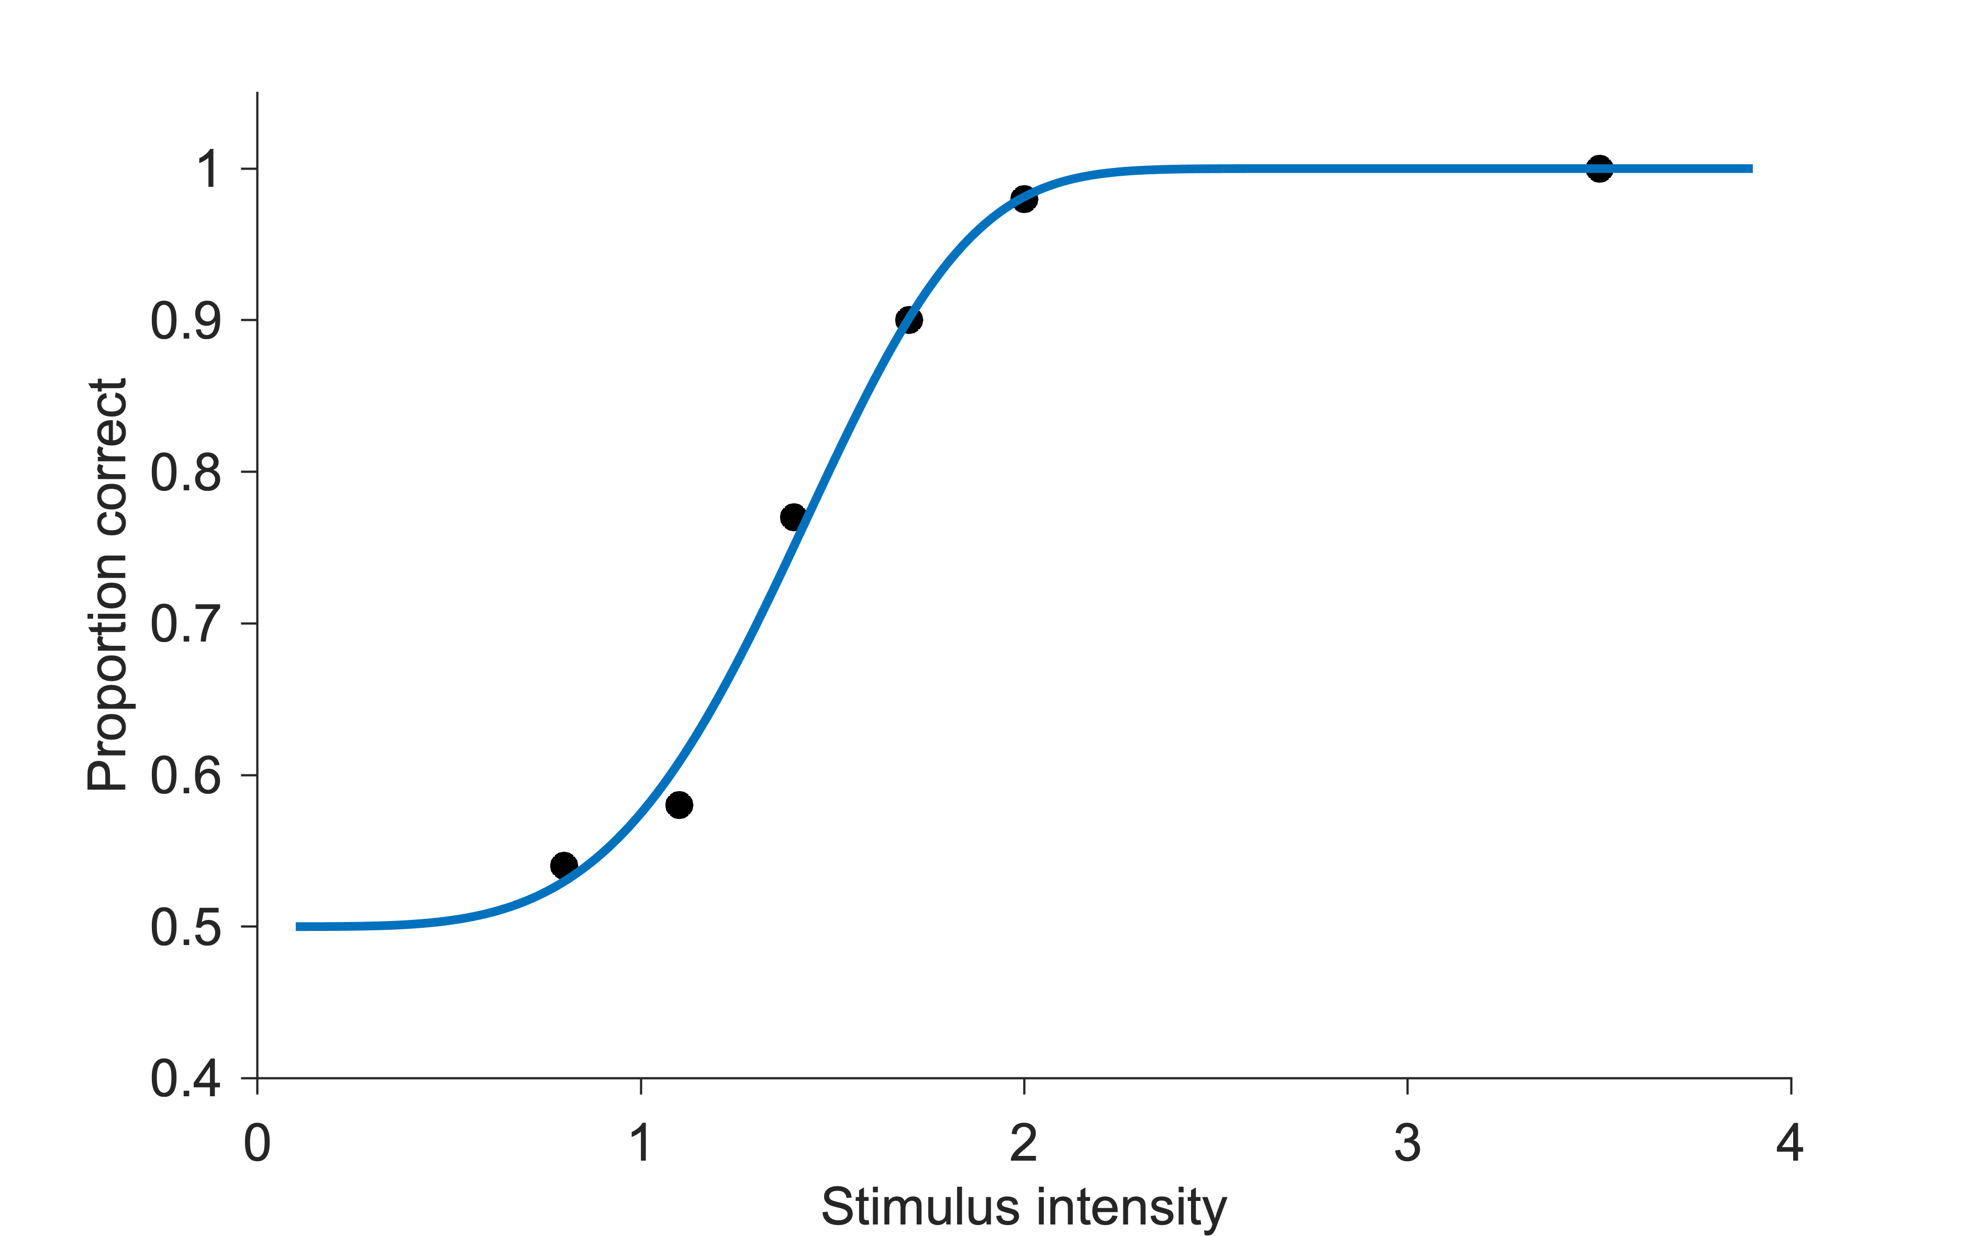
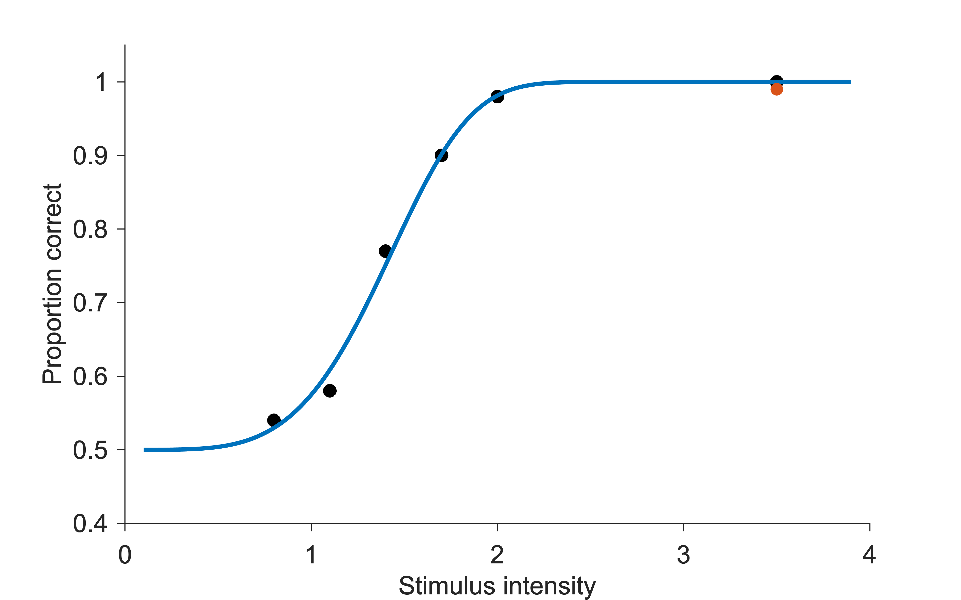
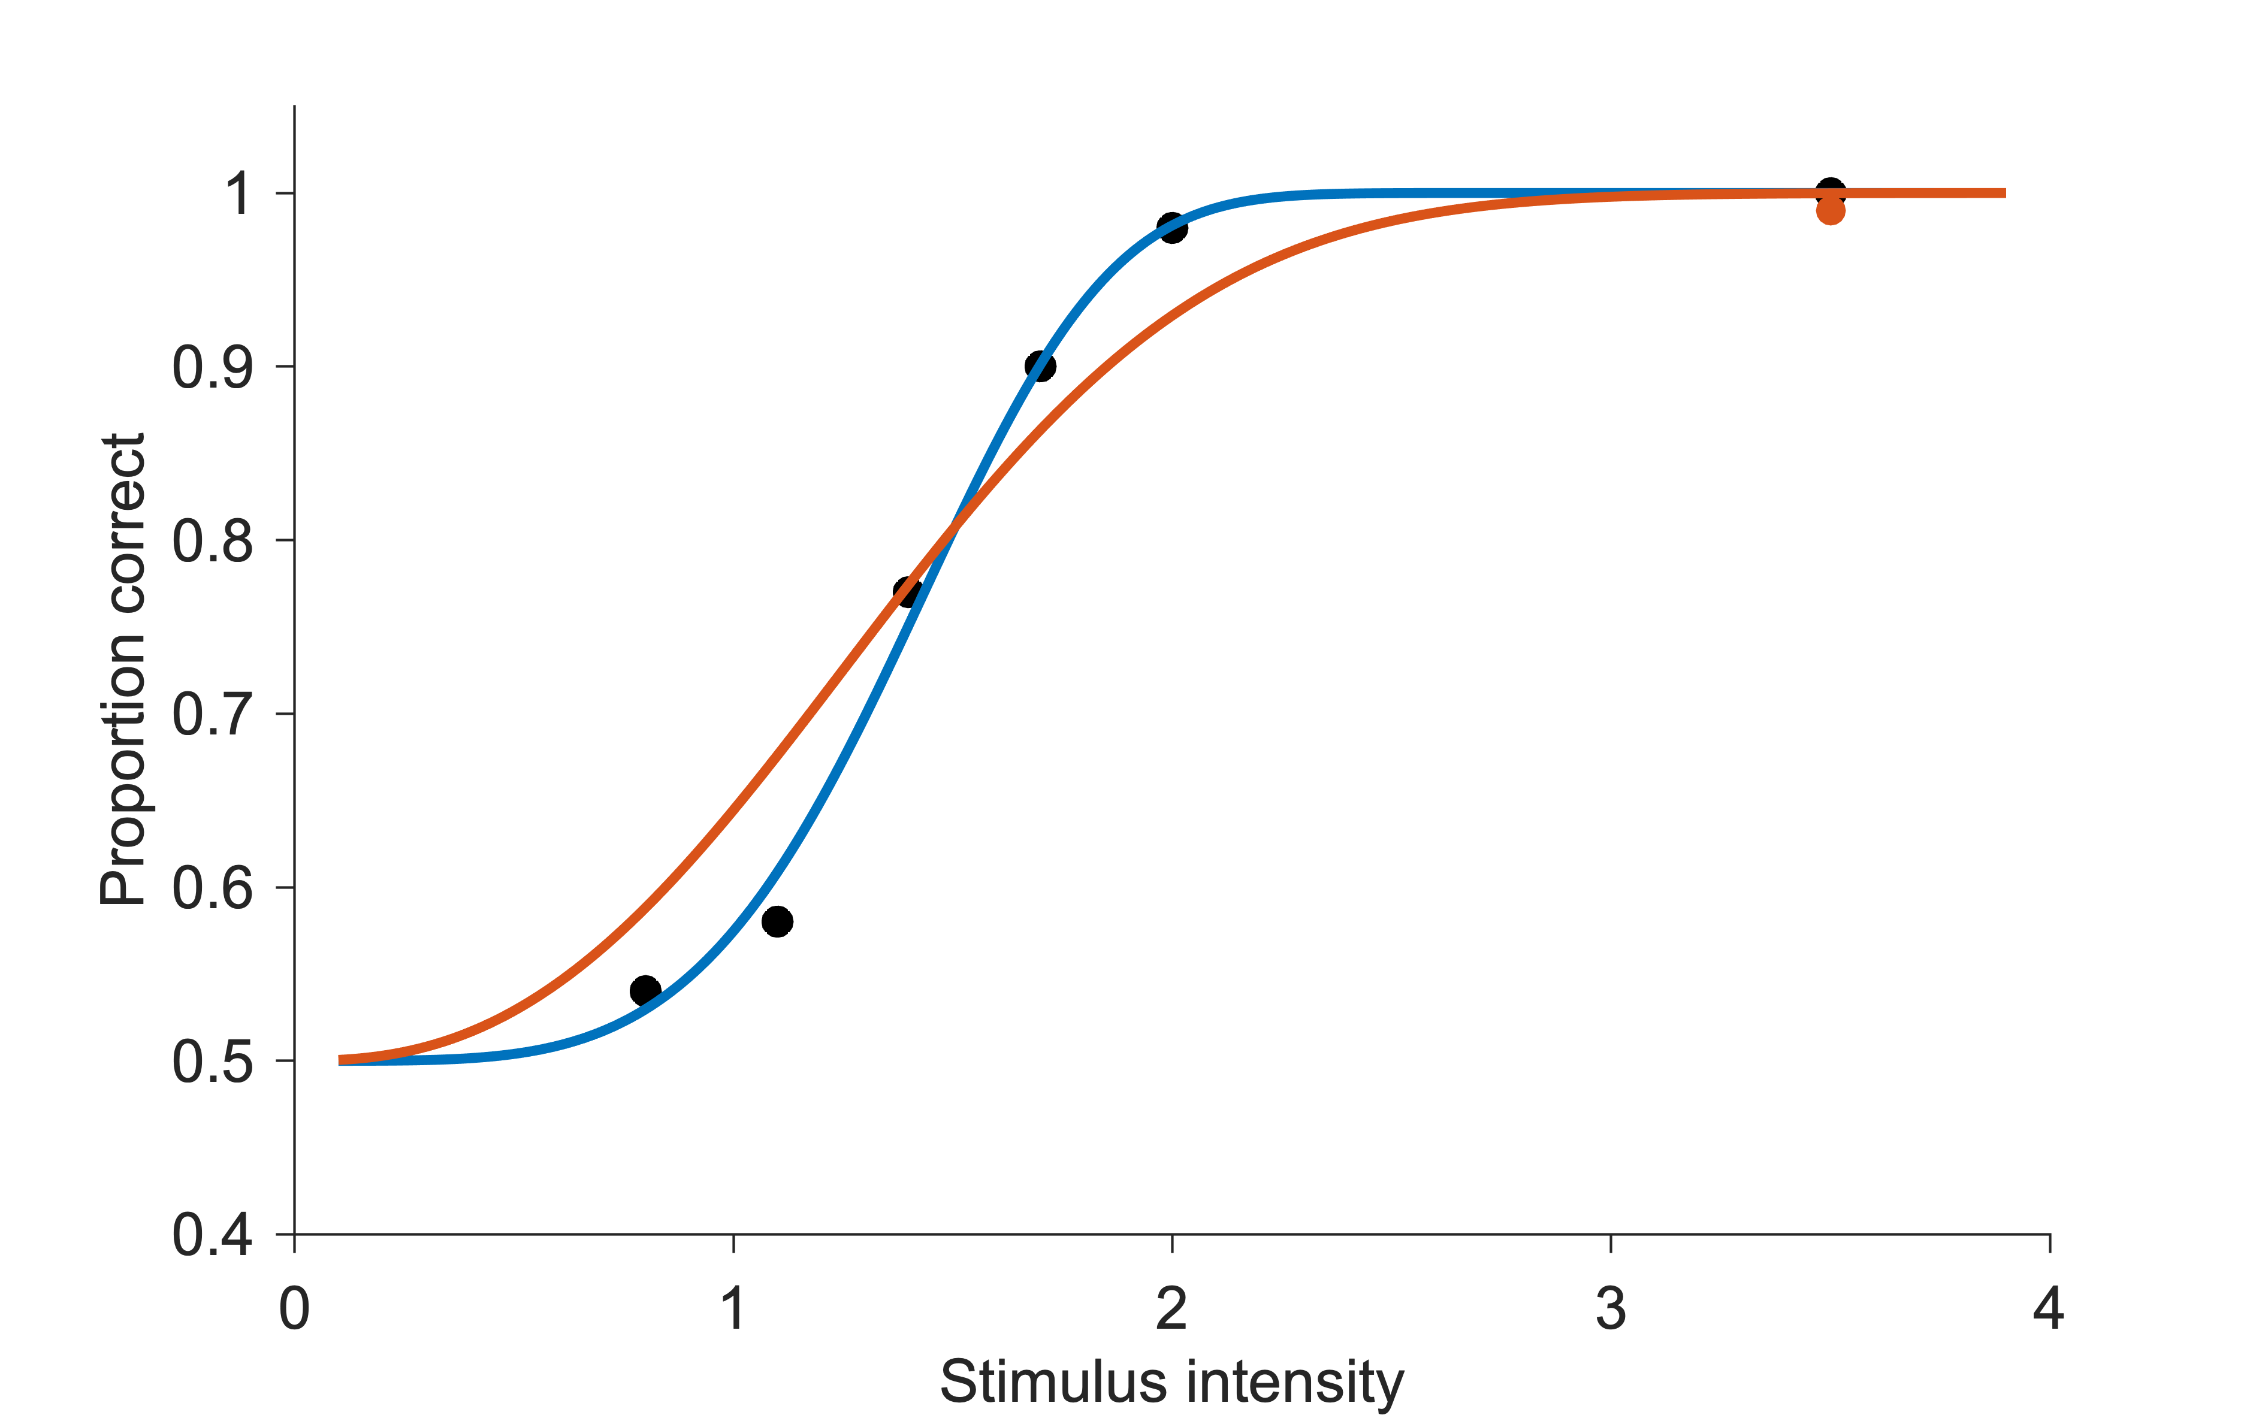
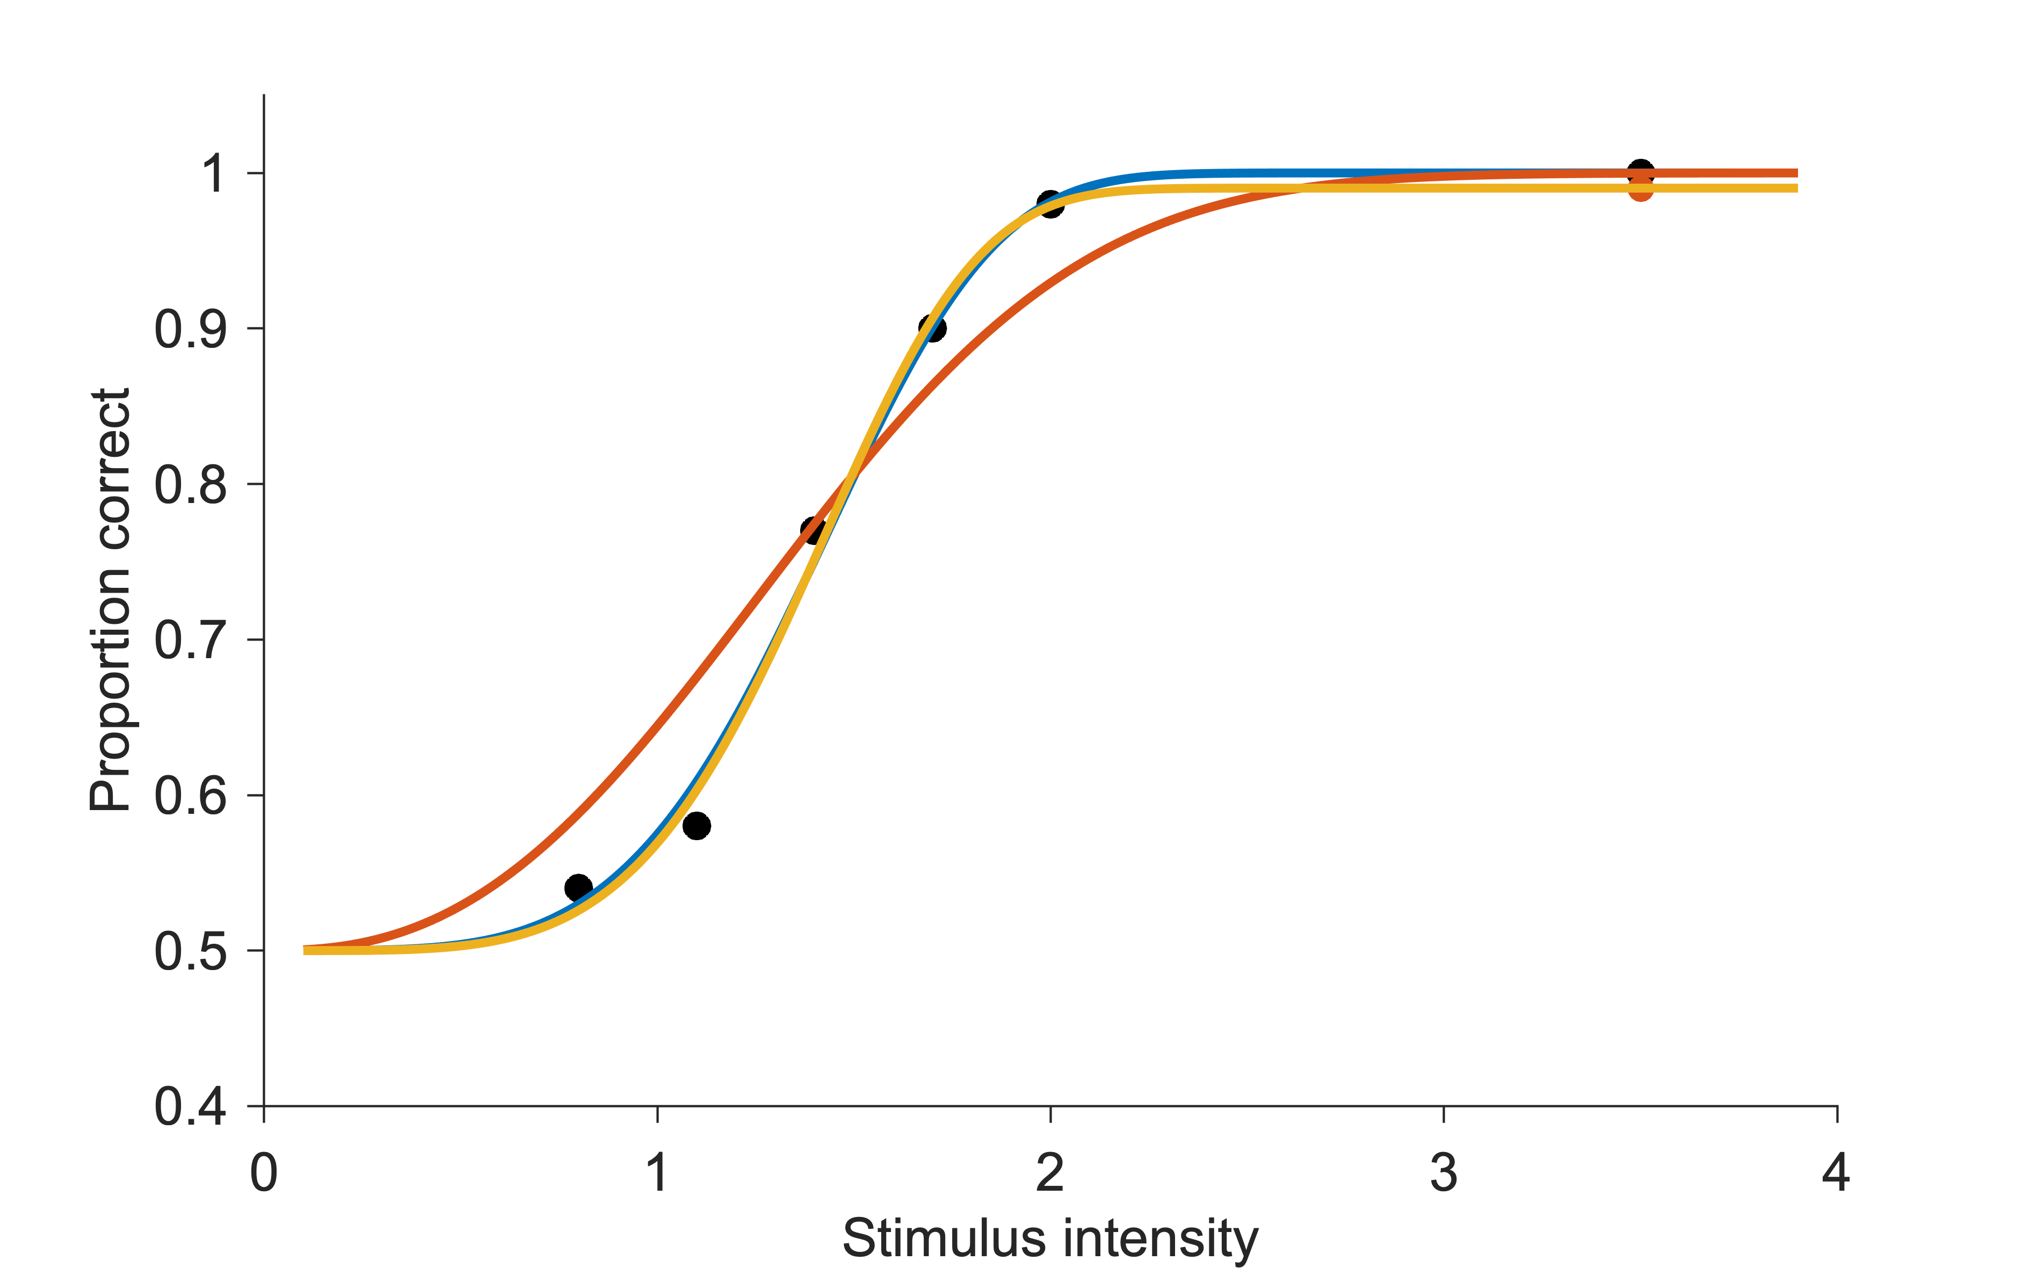
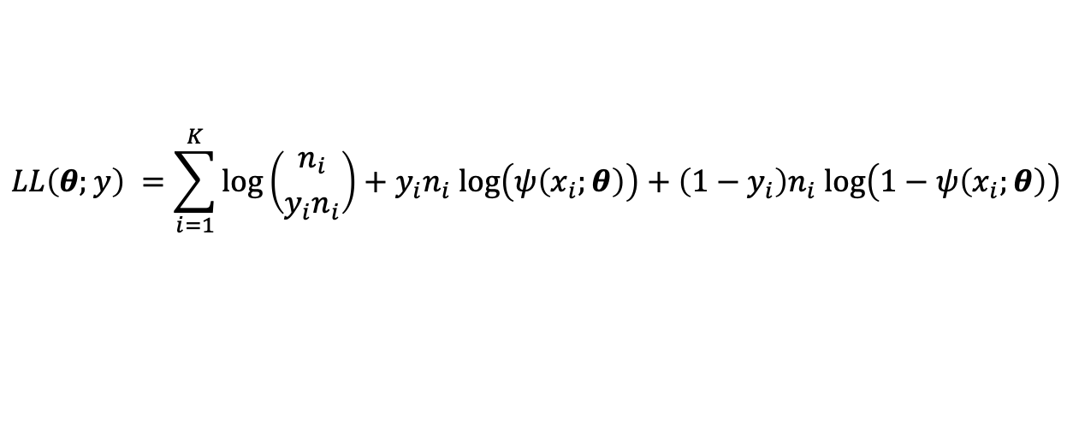
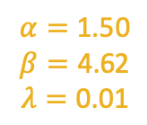
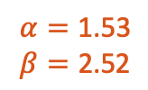
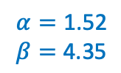
Lapses
$$α=\text{1.5}\text{2}$$
$$β=\text{4.}\text{35}$$
$$α=\text{1.5}\text{3}$$
$$β=\text{2}\text{.}\text{52}$$
$$α=\text{1.5}\text{0}$$
$$β=\text{4}\text{.}\text{62}$$
$$λ=\text{0}\text{.}\text{01}$$
Ground truth: Weibull function, $α=\text{1.57}$, $β=\text{4.36}$
$n_{i}=100$ trials per stimulus level
$$LL\left(θ;y\right) =\sum_{i=1}^{K}{\log\left({n_{i} \atop y_{i}n_{i}}\right)+y_{i}n_{i} log\left(ψ\left(x_{i};θ\right)\right)+\left(1−y_{i}\right)n_{i} log\left(1−ψ\left(x_{i};θ\right)\right)}$$
Wichmann & Hill, 2001
Notes:
Problem is the last term; phi -> 1 => log -> -inf; yi != 0 leads to a very large negative term; since the maximum is 1 (without lapse rate) => curve becomes shallower
Typical lapse rate: 0.01 – 0.06
In the cartoon => the data point for the lapse is actually outside of the shown interval (does not matter), but to avoid confusion

Slide 33
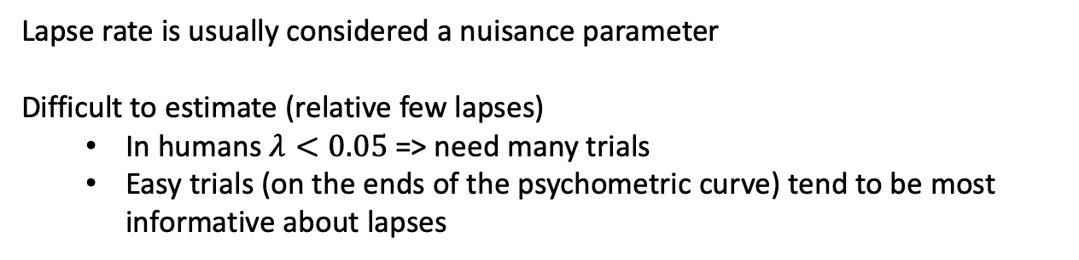
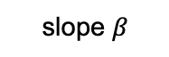
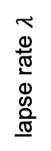
Lapses & parameter tradeoff
Lapse rate is usually considered a nuisance parameter
Difficult to estimate (relative few lapses)
In humans $λ<0.05$ => need many trials
Easy trials (on the ends of the psychometric curve) tend to be most informative about lapses
Parameter trade-off
Example: synthetic data
trade-off precision vs. lapses
lapse rate $λ$
slope $β$
Shen and Ma, 2017
actual parameters
Notes:
Problem is the last term; phi -> 1 => log -> -inf; yi != 0 leads to a very large negative term; since the maximum is 1 (without lapse rate) => curve becomes shallower
Typical lapse rate: 0.01 – 0.06

